Slide 1


APPLIED PHYSICS 186 – ACTIVITY 14
MACHINE LEARNING:
Logistic Regression
Professor: Dr. Maricor Soriano
Instructor: Jayson Cubero
Rene L. Principe Jr.
2015-04622

Slide 2
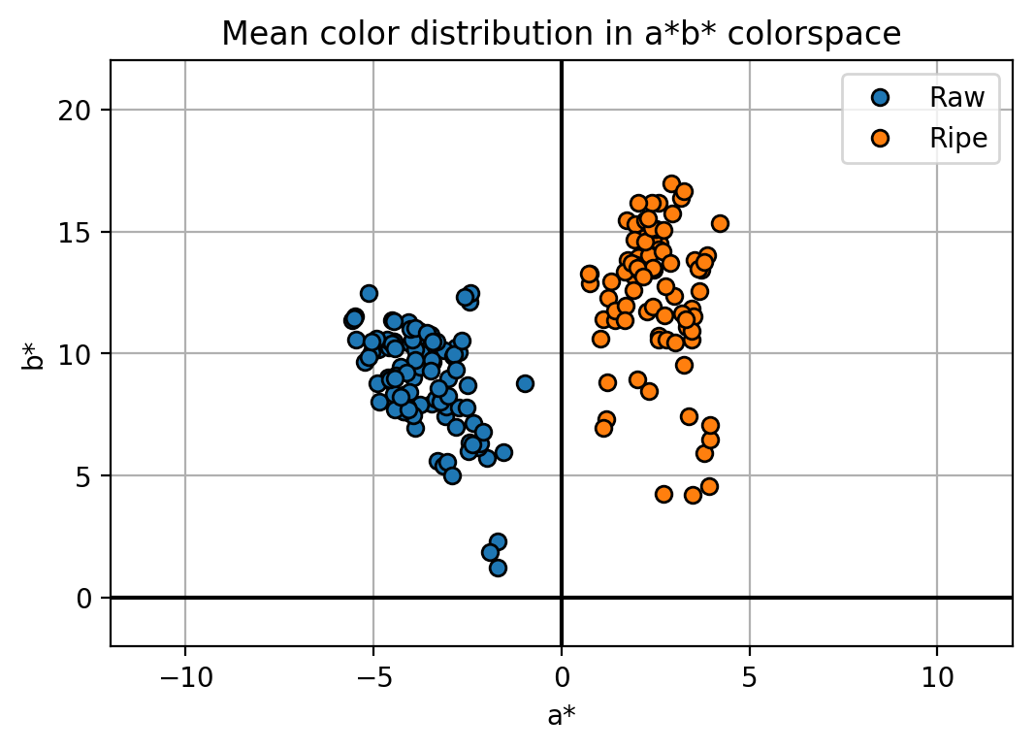
dataset
We have shown a successful binary classification between various fruit classes in the previous activity. In this report, a logistic regression problem was solved using our techniques in feature extraction and the perceptron algorithm. Logistic regression pertains to a classification of a continuous quantity, where the result isn’t 1 or 0 exclusively but rather, a percentage. Ripe (yellow) bananas were classified as 1 and the raw (green) ones are the 0. The dataset has separable color features as seen in the CIEL*a*b* colorspace as seen in Fig. 1. The dataset was trained to learn the weights using the mean red, green, and blue digital counts as feature inputs. In return, the perceptron can predict the ripeness of any input by activating the sigmoid value. Results are shown in the succeeding figures.
Figure 1. Color features a* and b* of raw and ripe bananas shall be used to determine a continuous ripeness variation.

Slide 3
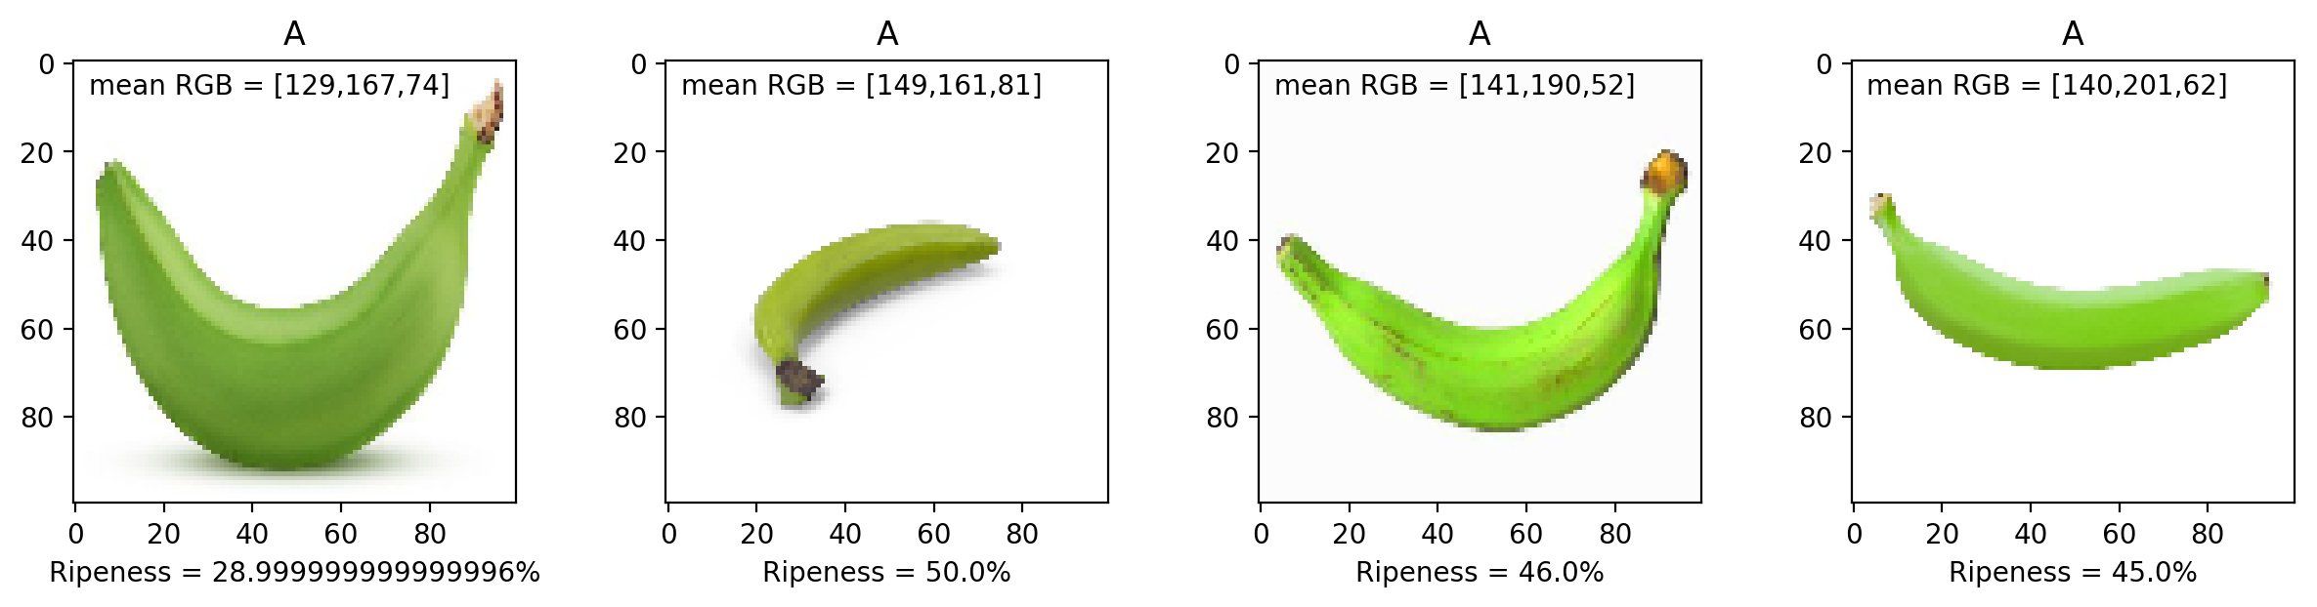
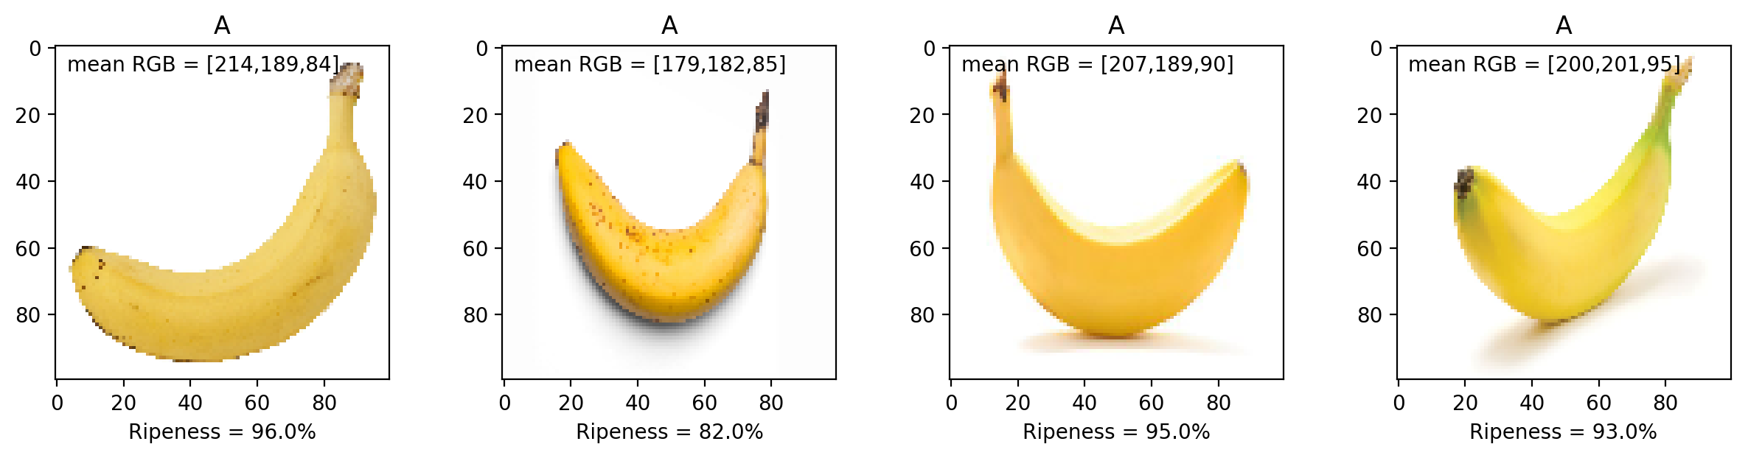
Figure 2. Ripeness prediction of never-before-seen images of raw and ripe bananas. Generally, raw bananas which are predominantly green in color has ripeness values below 50%, and the ripe yellow bananas have near 100% ripeness.

Slide 4
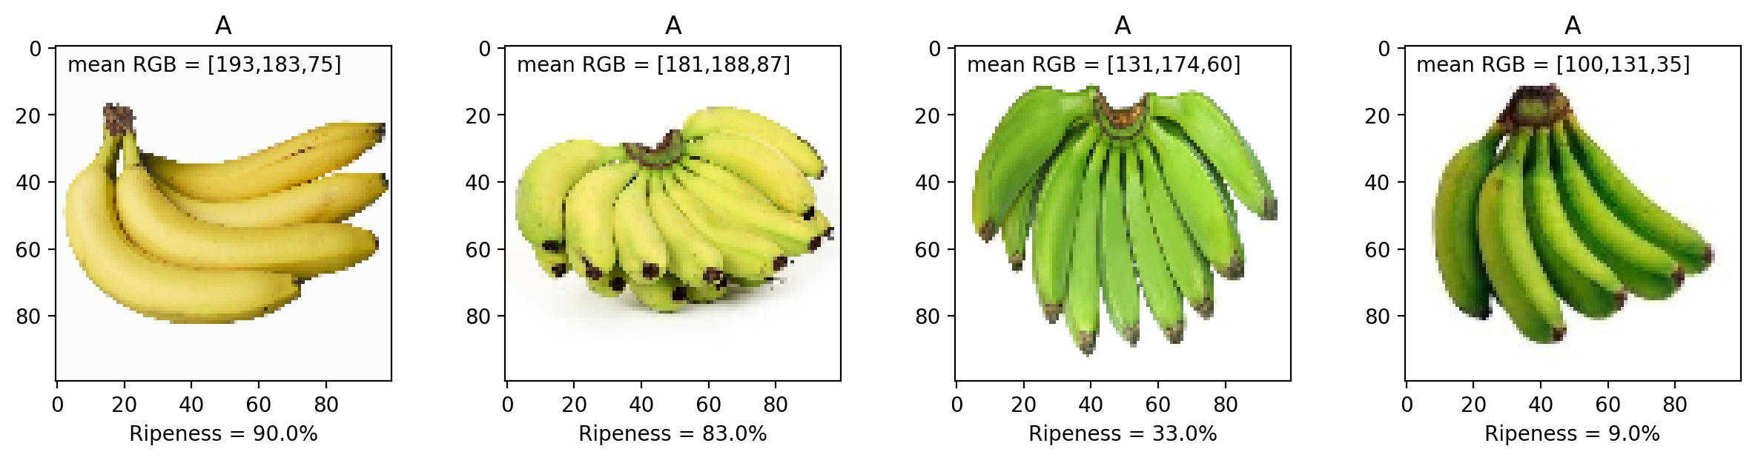
Figure 3. Ripeness has a direct correlation with color as per the logistic regression. The increase in the number of yellow pixels will introduce a shift in the mean RGB values, which in return would increase the sigmoid value, hence a higher ripeness prediction.
I have successfully quantified the ripeness of the banana fruit using its color features by the means of logistic regression. I’d give myself a 10.
I’d like to thank Kenneth Domingo for providing me a copy of the raw/ripe banana dataset.
References:
[1] M. Soriano, “Logistic Regression”, 2019.
[2] M. Oltean and H. Muresan, Fruits 360 dataset on kaggle. [Online; accessed 29.10.2019].

